Slide 1
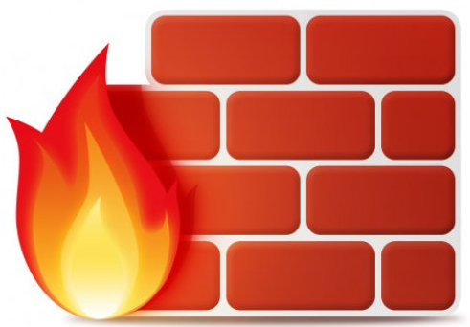


Going Past the Simple Firewall:
Implementing Security in Layers
Presented by:
Adam the Automator

Slide 2

About the Author
Pluralsight Author
PowerShell Trainer
Freelance Writer
PowerShell Consultant
Blog: adamtheautomator.com
Twitter: @adbertram
Microsoft Content/ Datacenter Management MVP

Slide 3






The Threat Landscape
Malware
Social Engineering
To learn more about Threats, read Symantec’s ISTR20 Internet Security Threat Report
Phishing
Ransomware

Slide 4





Threat Origination
Email
Social Networks
BYOD
Wireless

Slide 5

How to Discover Threats
Get between the user and the attacker
Deep Packet Inspection
SSL Decryption

Slide 6
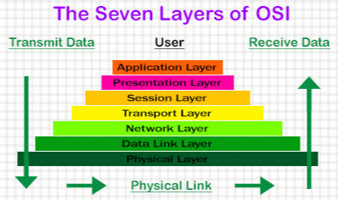
Layers are Necessary
Antimalware/ Antivirus
Firewall
Traditional port-based
SPAM filtering
Application level

Slide 7


Controlling Internet Usage
Internet link saturation
Productivity concerns
Quality of Service

